Slide 1
Financial decision making under uncertainty
Nathan Wang-Ly
MCR Talk (25 July 2023)
Supervisor: Prof Ben Newell

Slide 2

Financial decision making is hard…

Slide 3

… and is made more difficult by uncertainty
How much will I need to spend next month?
Do I really need insurance?
Is it worth putting extra money into my super?
How much will I earn this month?
What is the best way to invest my money?
Am I likely to get a pay rise this year?
How much should I set aside for emergencies?

Slide 4



My thesis examines three types of financial decisions involving uncertainty
Income uncertainty
Goal uncertainty
Goal uncertainty
Macroeconomic uncertainty
Macroeconomic uncertainty
How do we save when we don’t know how much we will need?
How do we save when our income is volatile?
How do we save when we don’t know how much we will need?
Who withdraws their savings during uncertain economic times?
Who withdraws their savings during uncertain economic times?

Slide 5
How this talk is structured
What is “uncertainty”?
Why is income uncertainty/volatility interesting to study?
Four lab experiments investigating income volatility and saving behaviour.
Implications and future directions.
Specific to income volatility.
About uncertainty more broadly.

Slide 6
01
What is uncertainty?

Slide 7


We all have an intuitive sense of what uncertainty is
We can distinguish between events that are certain and uncertain.

Slide 8


We all have an intuitive sense of what uncertainty is
We can also distinguish between levels of certainty.

Slide 9
However, the literature does not offer a single agreed-upon definition of uncertainty
“There are almost as many definitions of uncertainty as there are treatments of the subject” (Argote, 1982, p. 420).
Types of uncertainty that have been proposed:
Epistemic and aleatory uncertainty (Fox & Ülkümen, 2011).
Internal and external uncertainty (Howell & Burnett, 1978; Kahneman & Tversky, 1982).
Epistemological and ontological uncertainty (Davidson, 1996).
Fundamental, procedural, and weak uncertainty (Dequech, 2004).

Slide 10
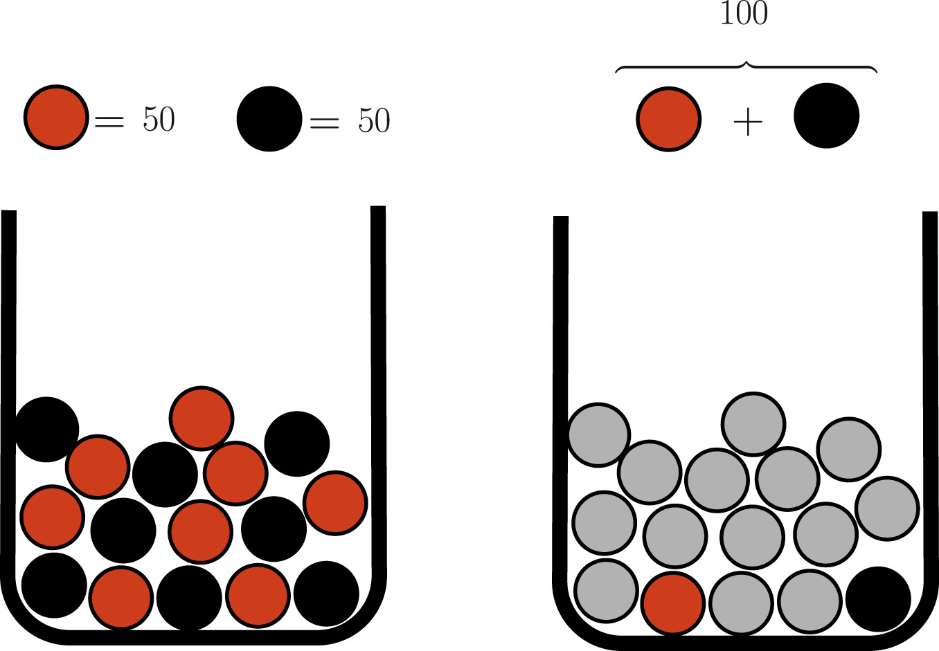
Keeping it simple: ‘Knightian uncertainty’
Refers to situations where the possible outcomes and their associated probabilities are both unknown and unmeasurable (Knight, 1921).
This differs from risk, where the probabilities are known (or measurable).
Illustrating the difference between uncertainty and risk—the Ellsberg (1961) urn task:
Risk
Uncertainty
Chance of drawing a black ball?
P(black) = 0.5
Chance of drawing a black ball?
P(black) = ???

Slide 11
Uncertainty is pervasive and unavoidable
How much will I need to spend next month?
Do I really need insurance?
Is it worth putting extra money into my super?
How much will I earn this month?
What is the best way to invest my money?
Am I likely to get a pay rise this year?
How much should I set aside for emergencies?

Slide 12
02
Why is income uncertainty interesting to study?

Slide 13



Many people must manage their finances without having stable incomes
A few examples:
Gig workers
Casual employees
Freelancers

Slide 14
Economic models and empirical studies suggest that income uncertainty should increase saving behaviour
According to economic lifecycle models (e.g., Friedman, 1957; Modigliani & Brumberg, 1954), people seek to smooth their consumption over their lives.
This leads people to accumulate ‘precautionary savings’, as they balance between present and future financial needs.
Based on these models, people who are uncertain about their future income should save more.
Many empirical studies have found evidence in support of this claim (Lugilde et al., 2018).
For example, Kazarosian (1997) observed that a 2x increase in past income volatility corresponded to a 29% increase in consumers’ wealth-to-income ratio (proxy for savings).
However, most of this research has focused on ‘inter-year’ volatility rather than ‘intra-year’.

Slide 15
Recent work on intra-year income volatility suggests that it can increase financial impatience
There have been two recent attempts to examine intra-year income volatility experimentally.
Both provide evidence that higher volatility results in greater financial impatience.
West et al. (2020)
Peetz et al. (2021)
Manipulation of income volatility
Provided income spikes to Kenyan recipients of unconditional cash transfers
Provided hypothetical income to lab participants for completing simulated work tasks.
Adapted ‘multiple-price list’:
Example choice:
KSH 500 today.
KSH 510 in 6 months.
Asked participants to choose at the end of the task:
USD 15 today.
USD 17 in 2 weeks.
Measure of financial impatience

Slide 16
We wanted to (experimentally) examine the direct relationship between uncertainty and saving
Our research study was designed with the following aims in mind:
1
Contribute to the growing literature on intra-year income volatility.
Extend previous work to understand what other financial decisions are influenced by income volatility
(financial impatience → savings behaviour).
2
3
Better understand how people perceive volatility in their income.

Slide 17
03
Four lab experiments investigating income volatility and saving behaviour

Slide 18
Overview of experiments
Four lab experiments (N = 712) involving UK participants recruited via Prolific.
Participants completed a financial decision making task that involved ‘working’ for income and making choices between spending and saving.
Manipulated the volatility of participants’ income, as measured by the ‘coefficient of variation’ (CV).
CV = Standard deviation (of a sequence) / Mean (of a sequence).
CV ranges from 0 (no volatility) to infinity.
Results based on Bayesian statistical analyses.
BF₁₀ indicates likelihood of evidence favouring alternative hypothesis over null hypothesis.
Interpretations of Bayes factors based on suggestions in Lee and Wagenmakers (2013).

Slide 19
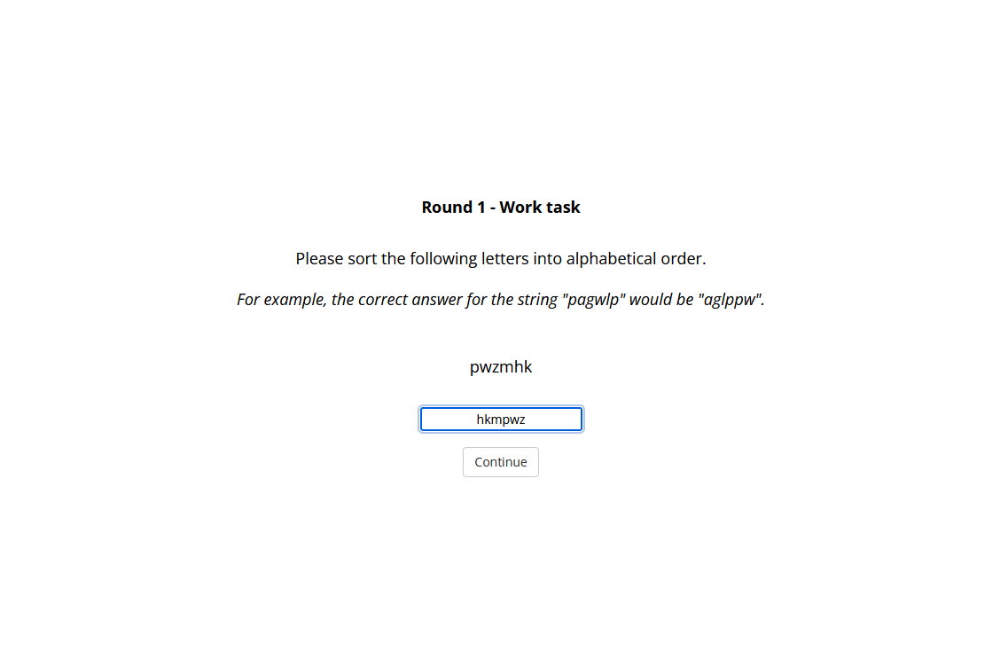
About the task: Working for income
Participants completed work tasks for income.
Total income after completing all tasks was the same for all participants (£15,000).
Between conditions, we manipulated whether the income per task was constant (e.g., £1,000 per task) or varied (e.g., £431 - £1,340 per task).
Within conditions, we randomised the order of incomes.

Slide 20
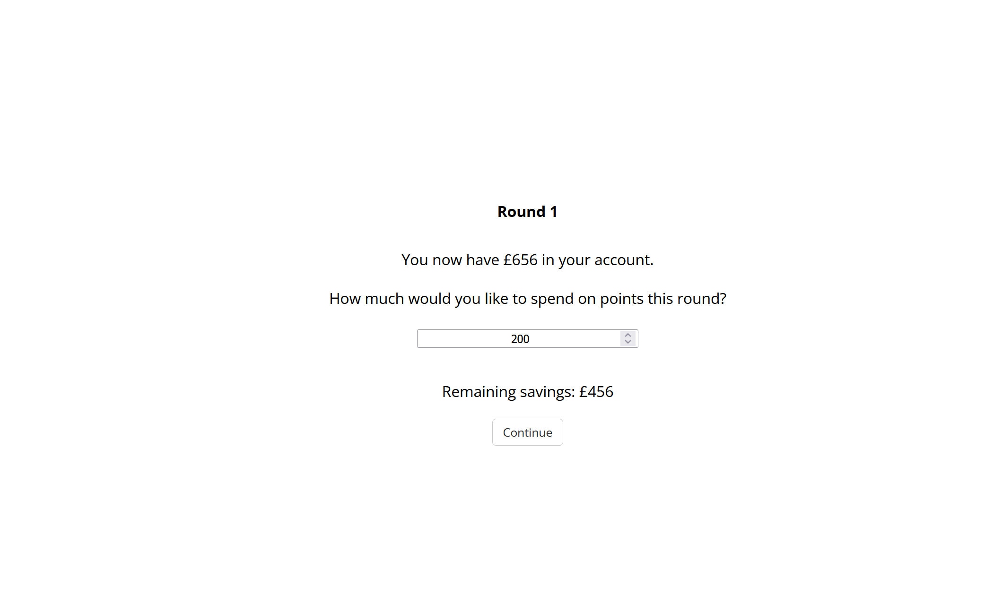
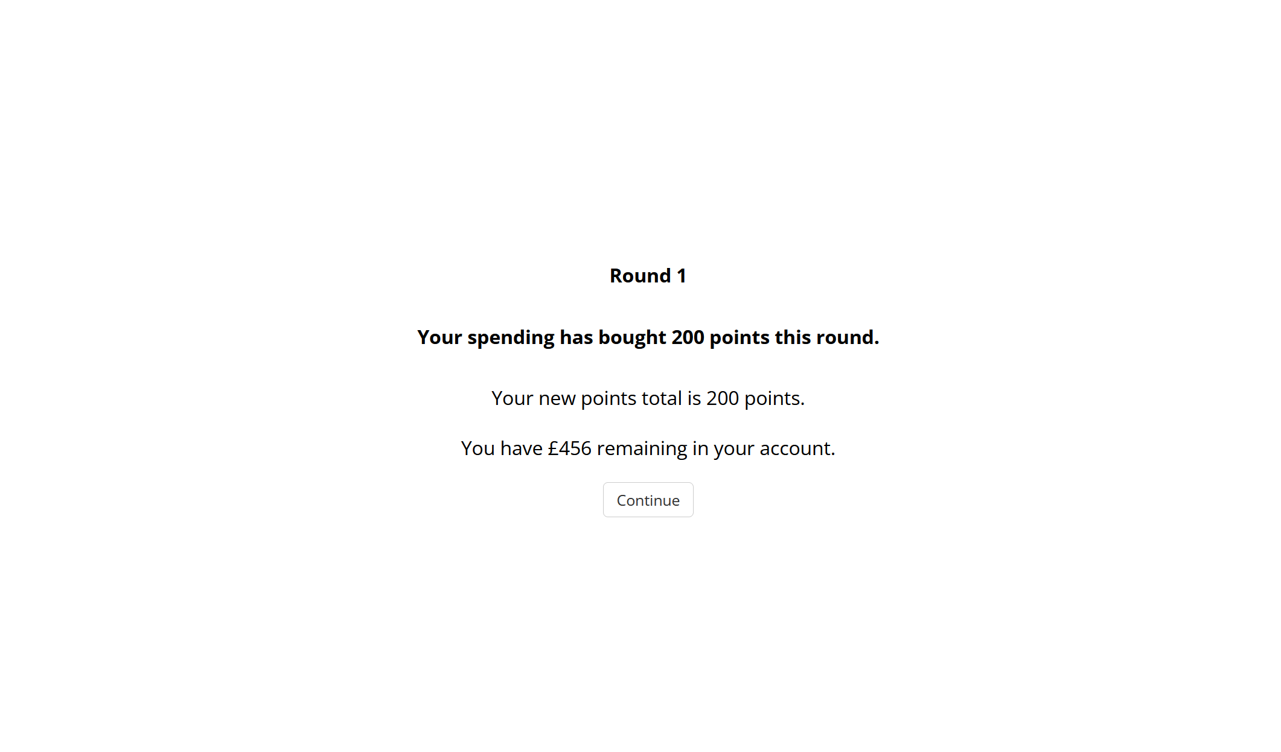
About the task: Spending vs saving
After each task, participants decided how much of their money to allocate towards buying points.
Any money that wasn’t spent would be carried over to the next round.

Slide 21
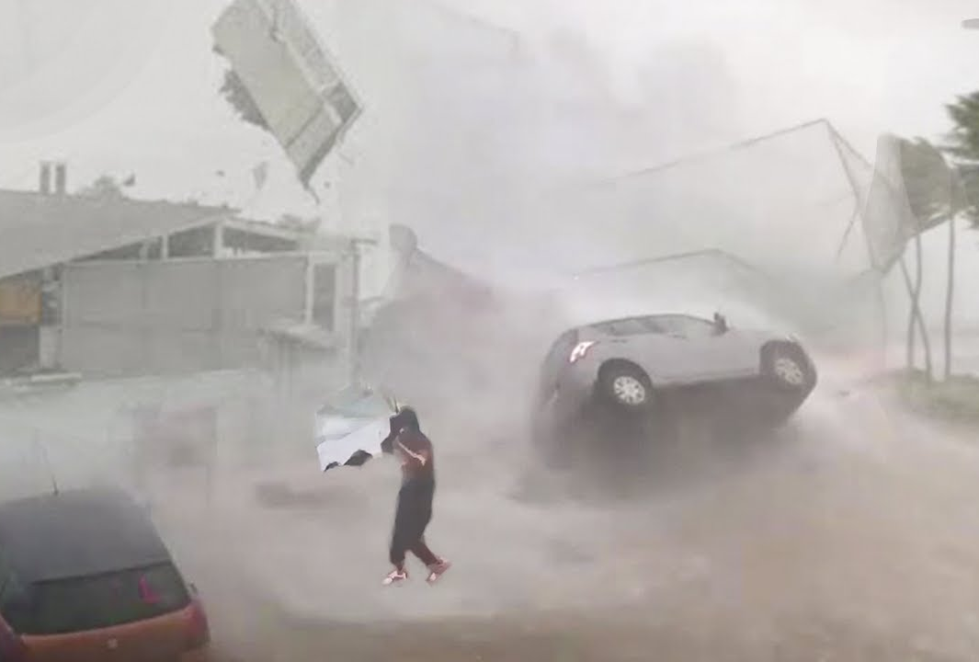
About the task: The financial emergency
At the end of the task, participants were hit with a financial emergency (storm damage).
The game outcome was determined by whether participants had saved enough to withstand the emergency (£6,000).
If participants had enough saved, they kept their purchased points.
Top 10% scoring participants won a bonus payment.
Participants without enough savings lost all of their points.
Participants were aware that the financial emergency would occur but not when nor how much it would cost.
This was always after the 15th round.

Slide 22
Experiment 1: Design
All participants (N = 241)
No Volatility (n = 81)
Low Volatility (n = 80)
High Volatility (n = 80)
Participants received £1,000 per work task.
CV = 0
Income per task ranged between £431-£1,340.
CV = 0.30
Income per task ranged between £173-£2,088.
CV = 0.60
Perceived volatility: “On a scale of 0 to 10, how volatile do you think the income you received in this task was?”
[0 = Not volatile at all; 10 = Extremely volatile]
Dependent measures
1
2
Final savings: Savings at end of task (15th round).

Slide 23
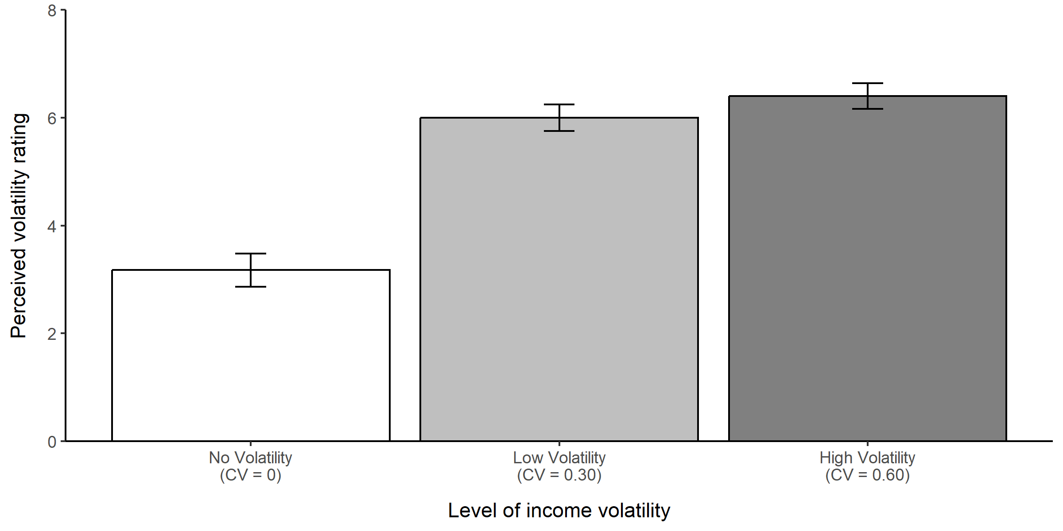
Experiment 1: Perceived volatility ratings
Extreme evidence that participants perceived income in the Low and High Volatility conditions as more volatile than the No Volatility condition (BF₁₀ = 2.04x10⁸ and 1.11x10¹¹).
Moderate evidence that ratings did not differ between Low and High Volatility conditions (BF₀₁ = 3.15).

Slide 24
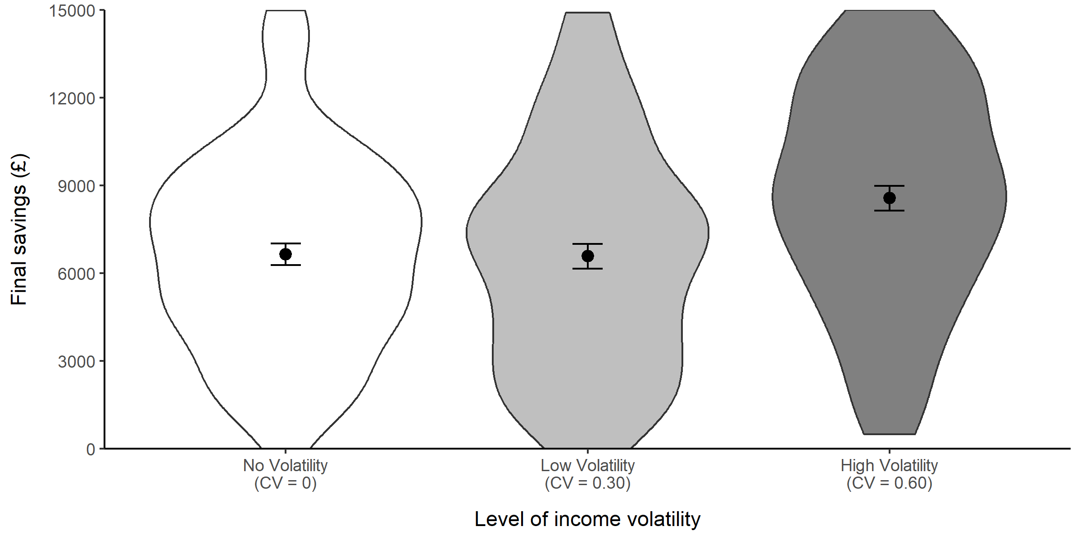
Experiment 1: Final savings
Strong/Very strong evidence that participants saved more in the High Volatility condition than the No and Low Volatility conditions (BF₁₀ = 33.67 and 24.23).
Moderate evidence that final savings did not differ between No and Low Volatility conditions (BF₀₁ = 5.84).

Slide 25
Experiment 1: Discussion
Our income volatility manipulation worked (partially) as intended.
Preliminary evidence that higher income volatility results in increased saving behaviour.
Consistent with previous economic studies.
Needed to further investigate the behaviour of Low Volatility condition.
Perceived income to be more volatile than No Volatility.
However, showed similar savings behaviour.
Hypothesis for Experiment 2:
Do other dimensions of our income sequences better explain saving behaviour than CV?
Hypothesis was inspired by Konovolova & Pachur (2021).
Volatility | Incomes (£) | CV | Min | Max | Range
No | 1,000 1,000 1,000 1,000 1,000 1,000 1,000 1,000 1,000 1,000 1,000 1,000 1,000 1,000 1,000 | 0.00 | 1,000 | 1,000 | 0
Low | 431 570 656 794 873 883 910 990 1,158 1,202 1,277 1,279 1,311 1,326 1,340 | 0.30 | 431 | 1,340 | 909
High | 173 274 466 526 529 650 661 847 1,101 1,374 1,404 1,436 1,571 1,900 2,088 | 0.60 | 173 | 2,088 | 1,915

Slide 26
Experiment 2: Design
All participants (N = 241)
From Exp 1
High Volatility (n = 80)
Same Min (n = 81)
Same Max (n = 80)
Same Range (n = 80)
Min income: £173
Max income: £2,088
Range: £1,915
CV = 0.60
Min income: £173
Max income: £1,580
Range: £1,407
CV = 0.37
Min income: £681
Max income: £2,088
Range: £1,407
CV = 0.37
Min income: £173
Max income: £2,088
Range: £1,915
CV = 0.37

Slide 27
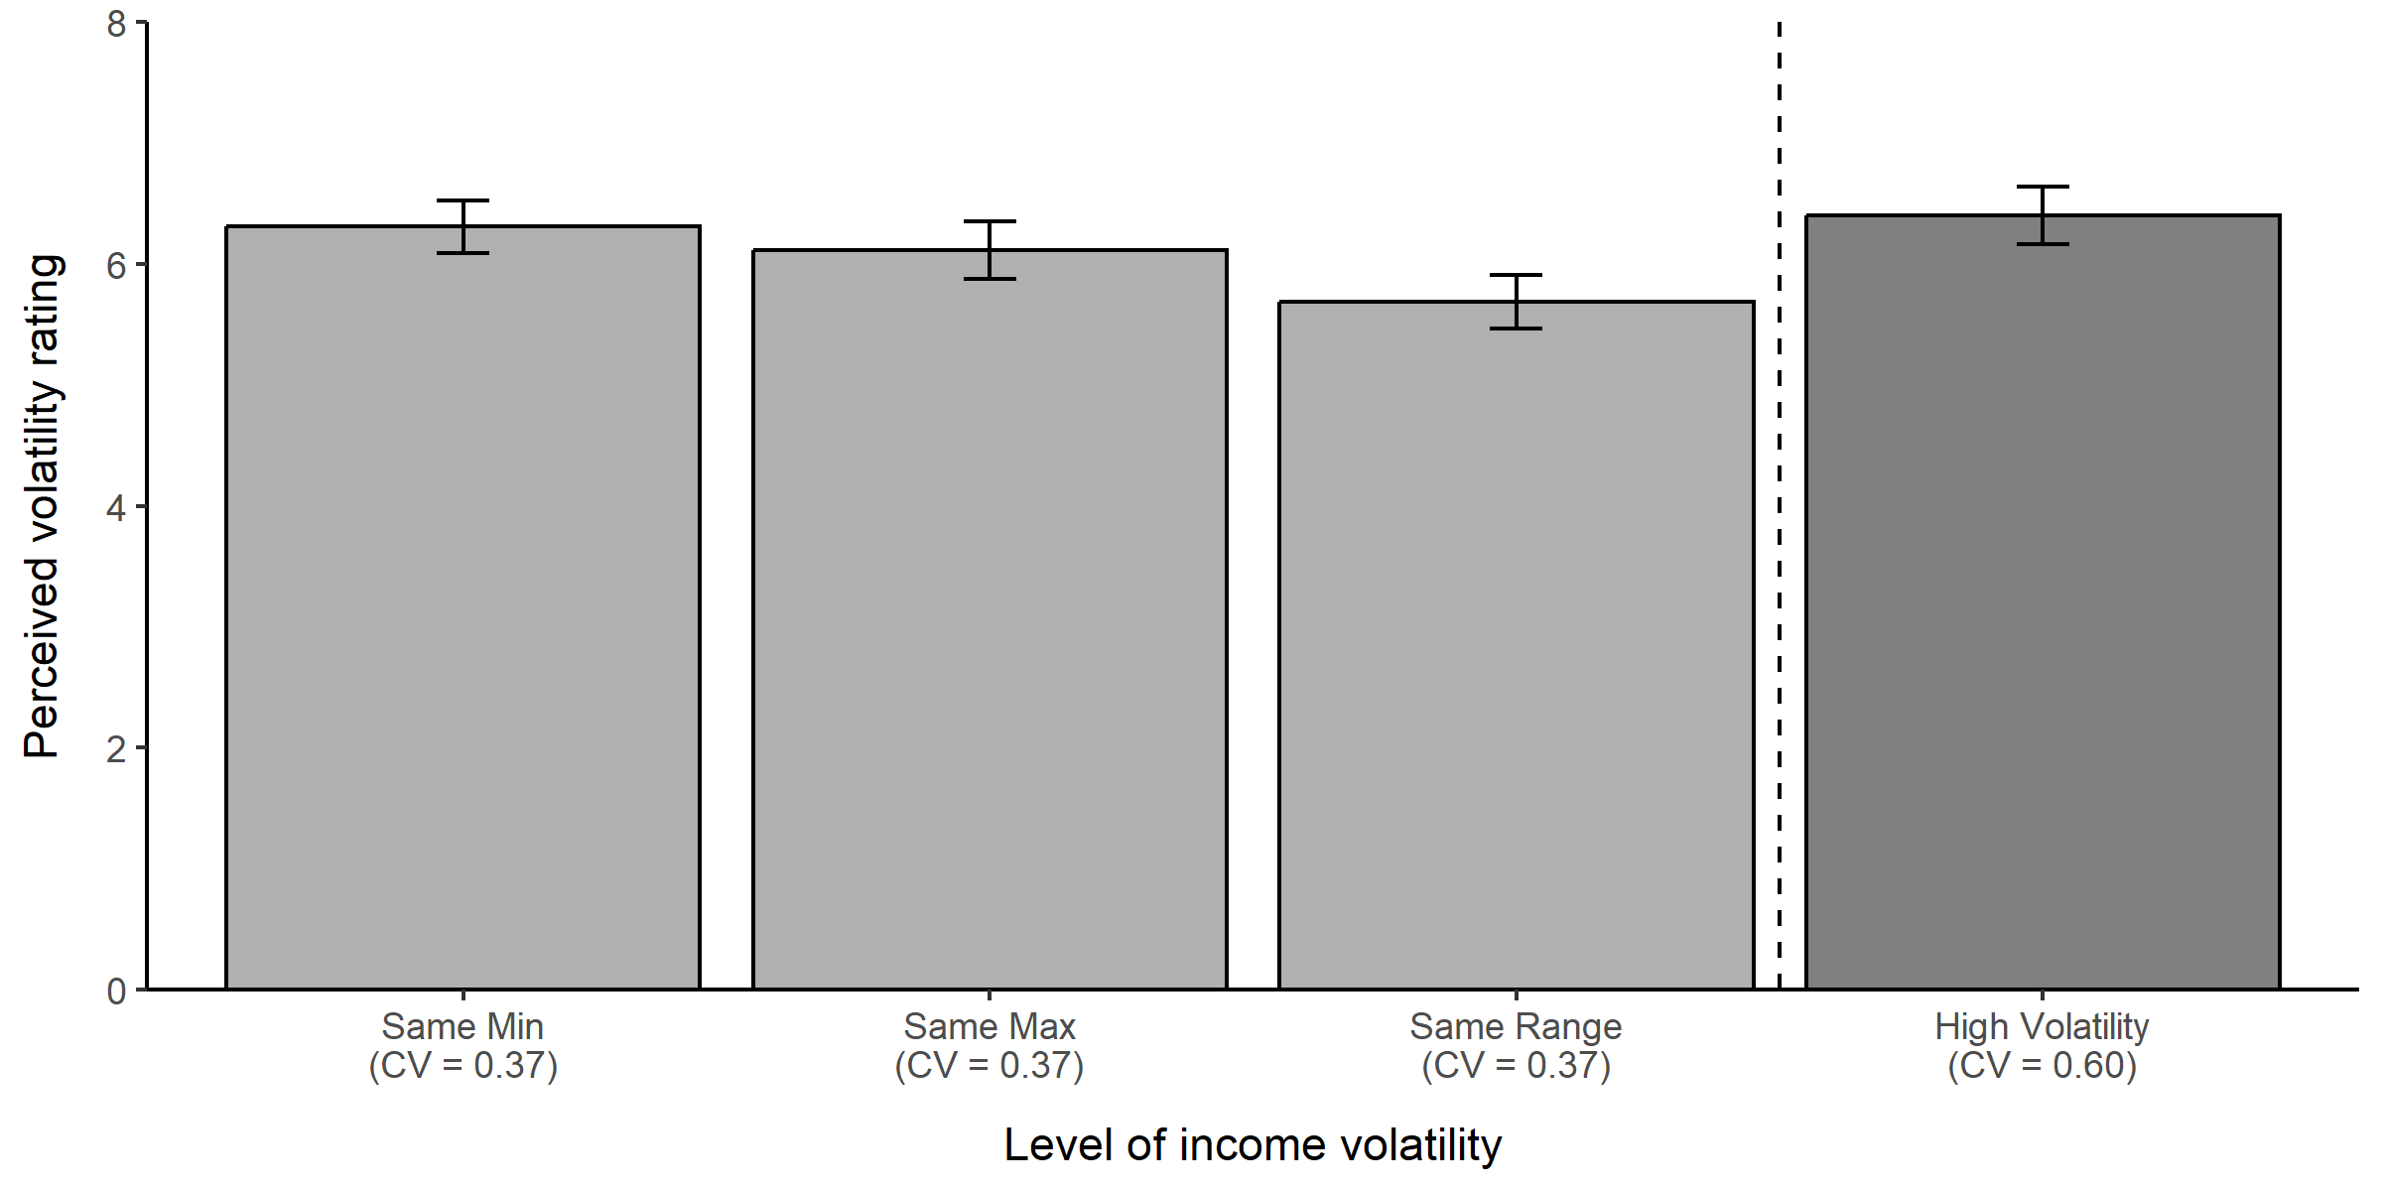
Experiment 2: Perceived volatility ratings
Moderate evidence that perceived volatility ratings did not differ between our Exp 2 conditions (BF₀₁ = 3.91).
Mixed evidence about whether perceived volatility ratings differed from High Volatility condition from Exp 1.
Anecdotal evidence that High Volatility > Same Range (BF₁₀ = 1.52).
Moderate evidence of no difference between High Volatility and Same Min or Same Max (BF₀₁ = 5.66 and 4.18).

Slide 28
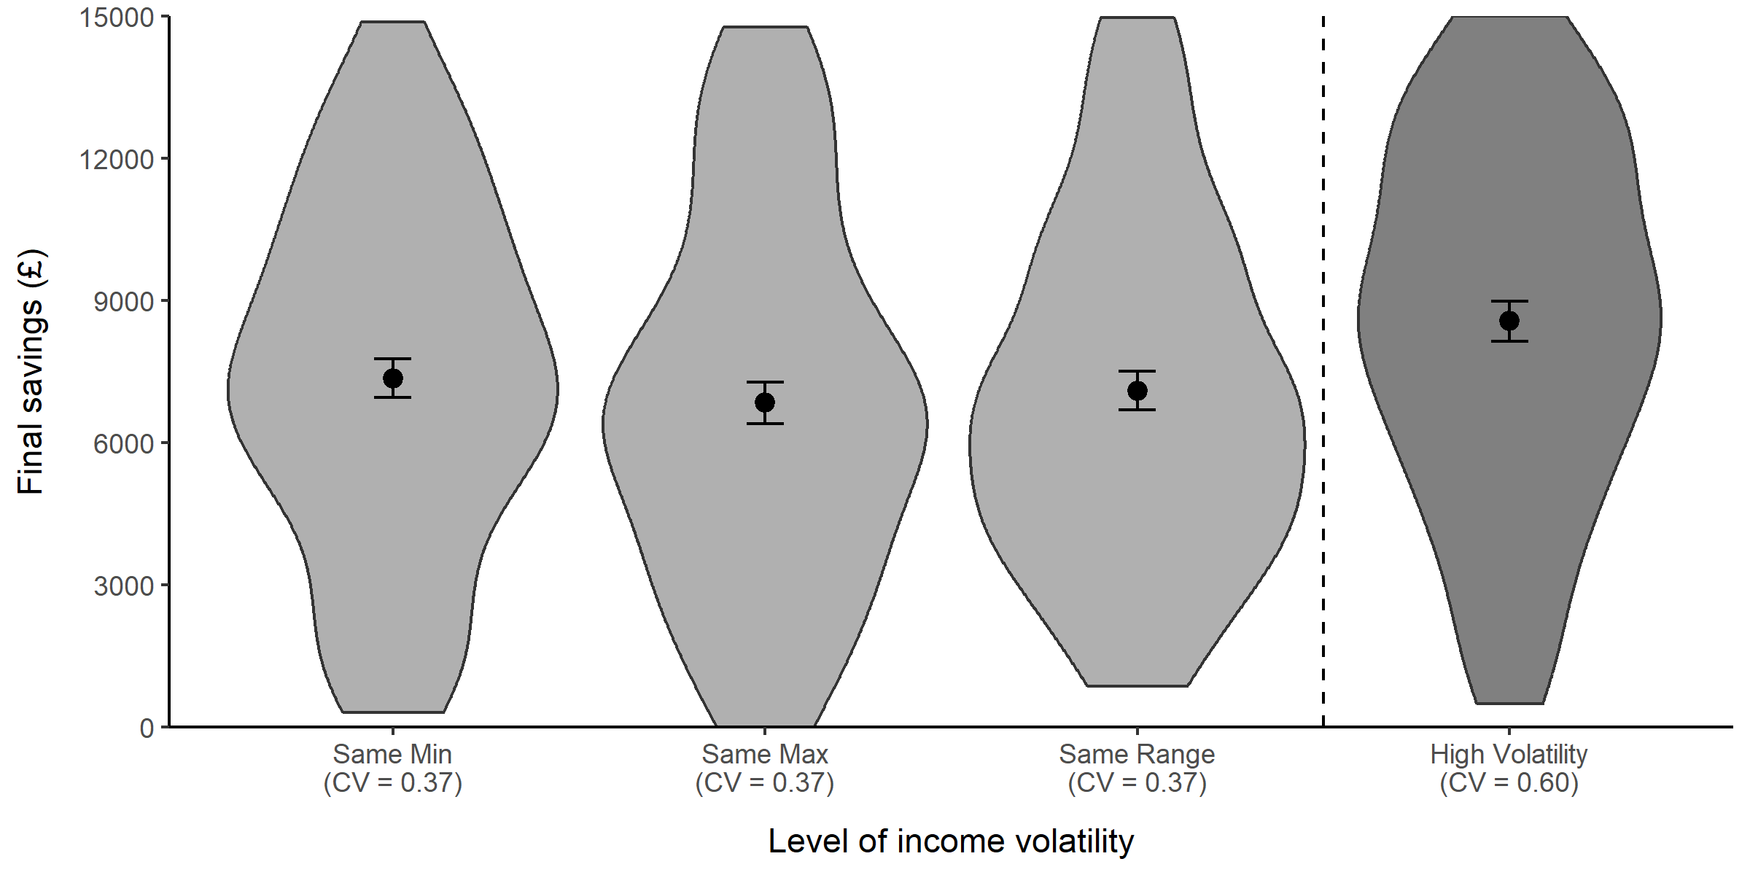
Experiment 2: Final savings
Strong evidence that final savings did not differ between our Exp 2 conditions (BF₀₁ = 16.19).
Consistent evidence that final savings were higher in High Volatility condition compared to the other three conditions.
Moderate evidence that High Volatility > Same Range and Same Max (BF₁₀ = 3.03 and 6.69).
Anecdotal evidence that High Volatility > Same Min (BF₁₀ = 1.16).

Slide 29
Experiment 2: Discussion
Our results did not support our Experiment 2 hypothesis.
Perceived volatility ratings and final savings did not differ between conditions despite varying the income sequences’ minimums, maximums, or ranges.
If anything, our results gave more reason to believe CV is driving saving behaviour.
Participants saved less in Exp 2 conditions (CVs = 0.37) compared to High Volatility condition (CV = 0.60).
However, we continued to observe a discrepancy between perceived volatility and saving behaviour.
Exp 2 conditions perceived as similarly volatile as High Volatility but saved less.
In Experiment 3, we considered an alternative hypothesis: participants are giving similar volatility ratings because it is an absolute judgment and not a relative judgment.
“There is some volatility, but not an extreme amount—so 7 out of 10”.
Motivated by prior work on absolute vs relative judgments (e.g., Fox & Tversky, 1995; Stewart et al. 2006).

Slide 30
Experiment 3: Allowing for relative judgments
In Experiment 3, we gave participants two attempts at the task.
Participants received the Low Volatility income for one attempt and the High Volatility income for the other.
Participants were told that the number of rounds before the emergency may differ between attempts.
Exp 1 & 2
Instructions
Work tasks
Perceived volatility Q
Reveal of emergency
Exp 3
Instructions
Work tasks
Perceived volatility Q
Work tasks
Perceived volatility Q
Reveal of both emergencies
1st attempt
2nd attempt

Slide 31
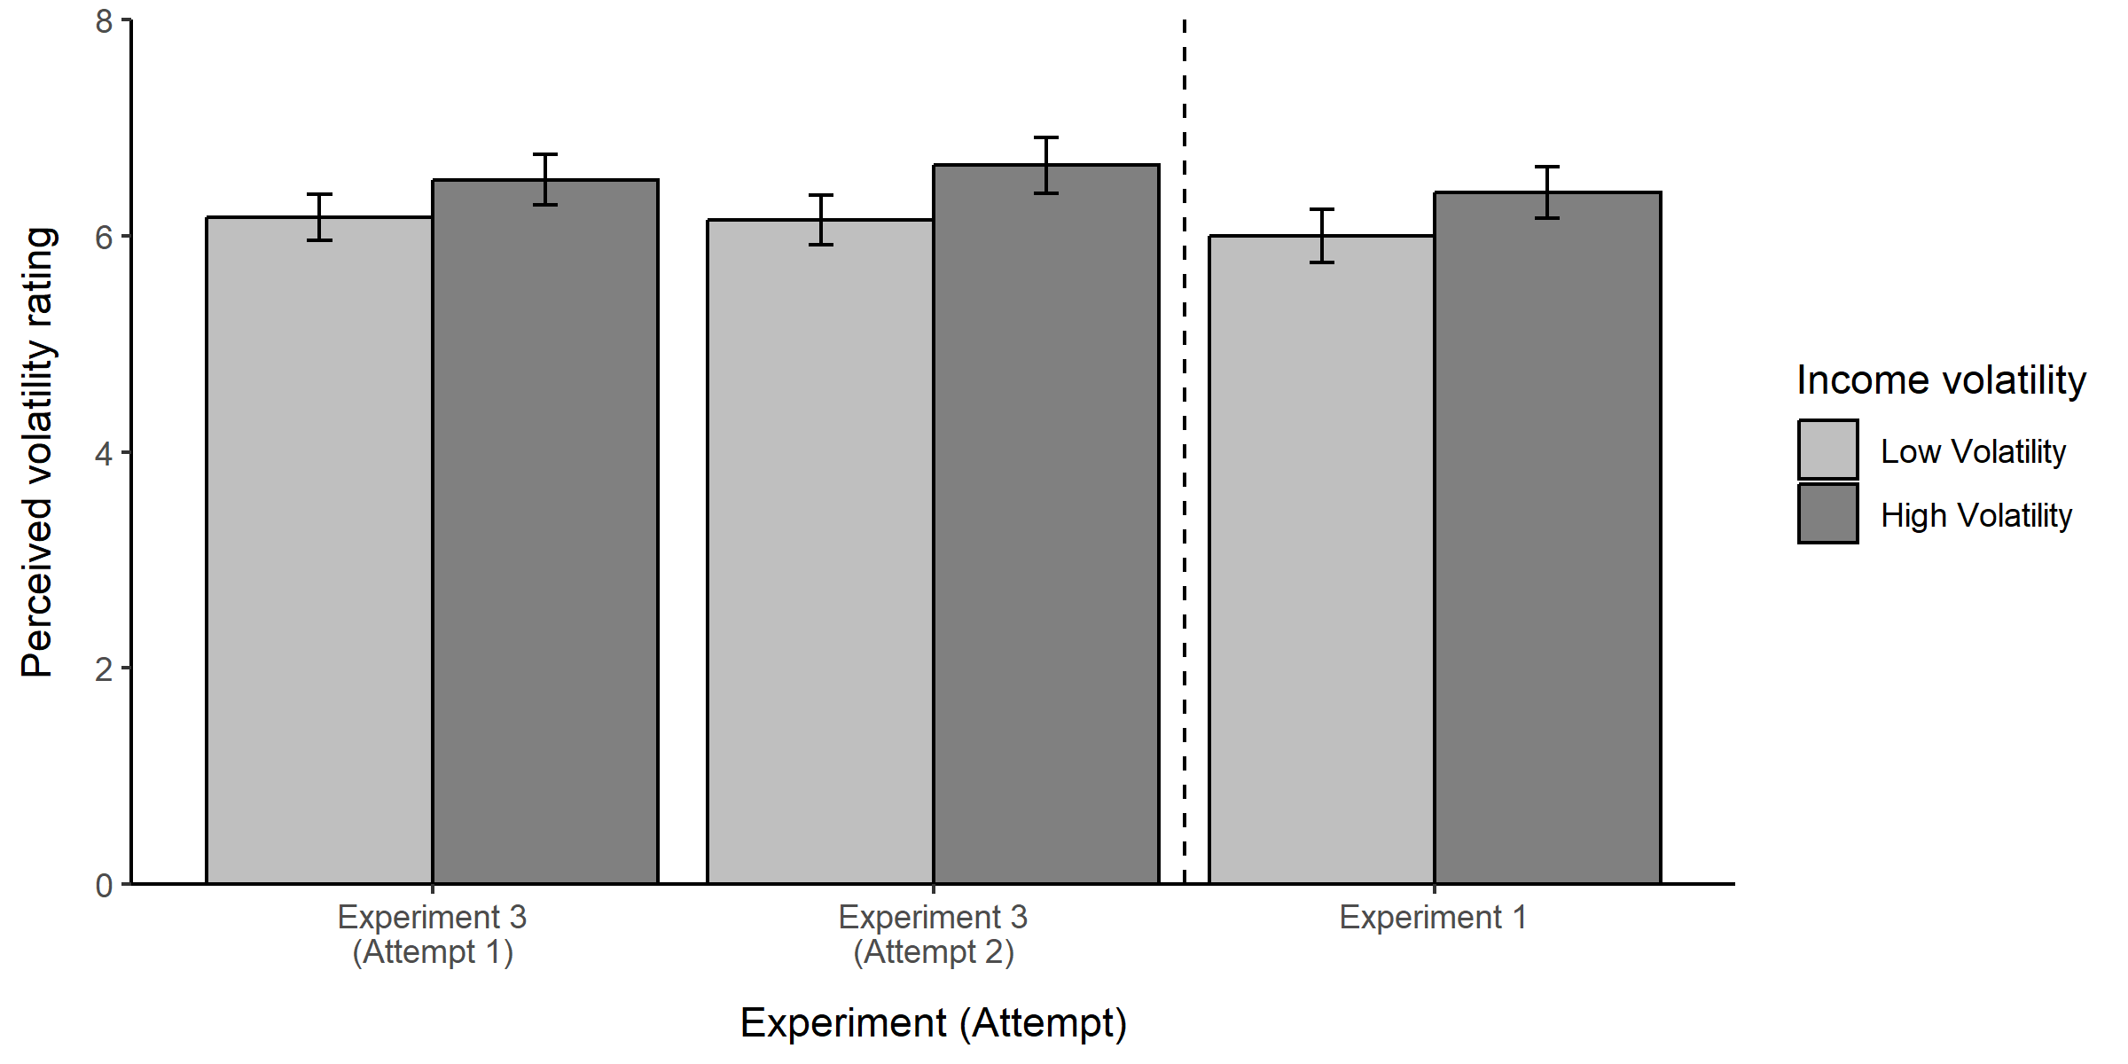
Experiment 3: Perceived volatility ratings
Anecdotal evidence that participants provided higher ratings during their High Volatility attempt than their Low Volatility attempt, regardless of attempt order (BF₁₀ = 2.91).
Mean difference in ratings of 0.43.

Slide 32
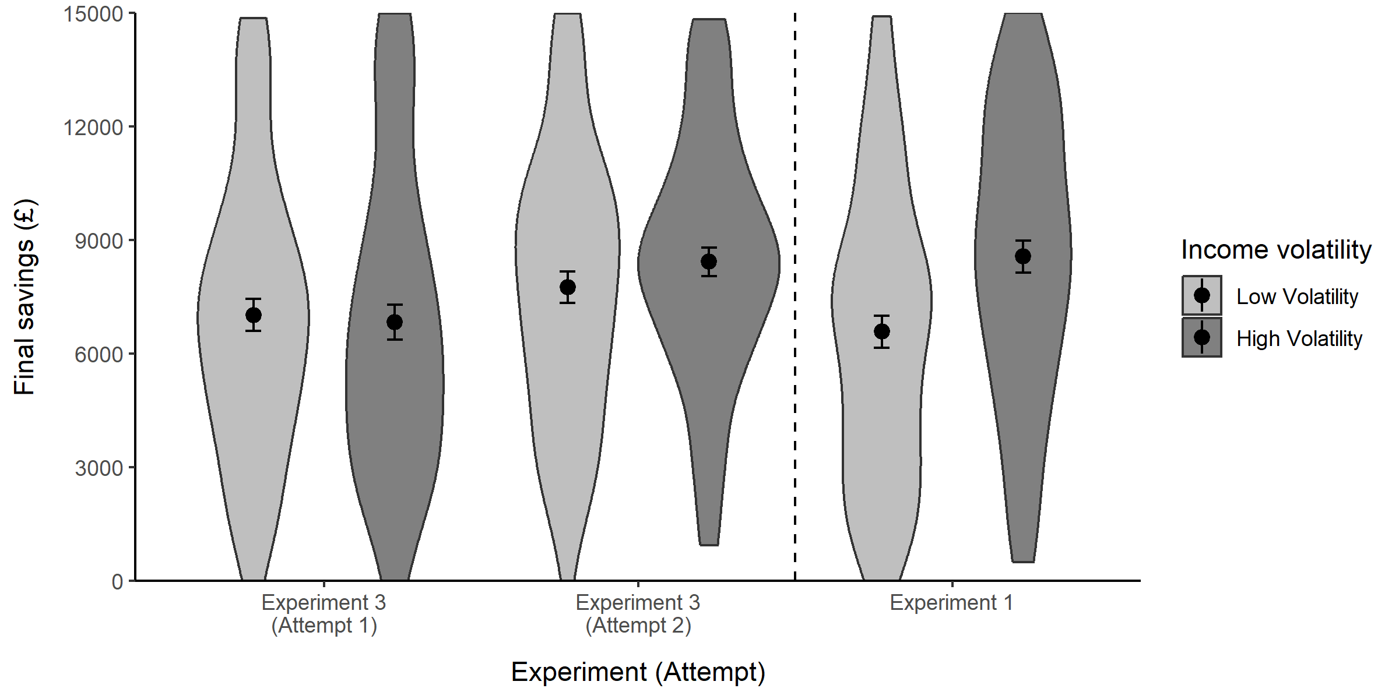
Experiment 3: Final savings
Moderate evidence against an income volatility level effect (BF₀₁ = 3.36).
Extreme evidence in favour of a task attempt effect (BF₁₀ = 5.01x10⁶).
Participants saved substantially more during their 2nd attempt regardless of whether they received a Low or High Volatility income.

Slide 33
Experiment 3: Discussion
Our results supported our Experiment 3 hypothesis.
We observed evidence that participants were distinguishing between the Low and High Volatility income sequences.
However, we no longer observed a difference in saving behaviour between the Low and High Volatility conditions (during participants’ first attempt).
Contradicted our original result from Exp 1.
We ran a final “Very High Volatility” condition to try and resolve our inconsistent findings.
If participants do not increase savings → Exp 1 may have been a false positive.
If participants do increase savings → Exp 3 may have been a false negative.

Slide 34
Experiment 4: Very High Volatility
Ran a single condition (n = 80) where participants were given an even more volatile income.
Incomes ranged between £44-£3,457.
CV = 0.90 (vs 0.60 in High Volatility).
Reverted to the procedure of Experiments 1 and 2—participants only had one attempt.

Slide 35
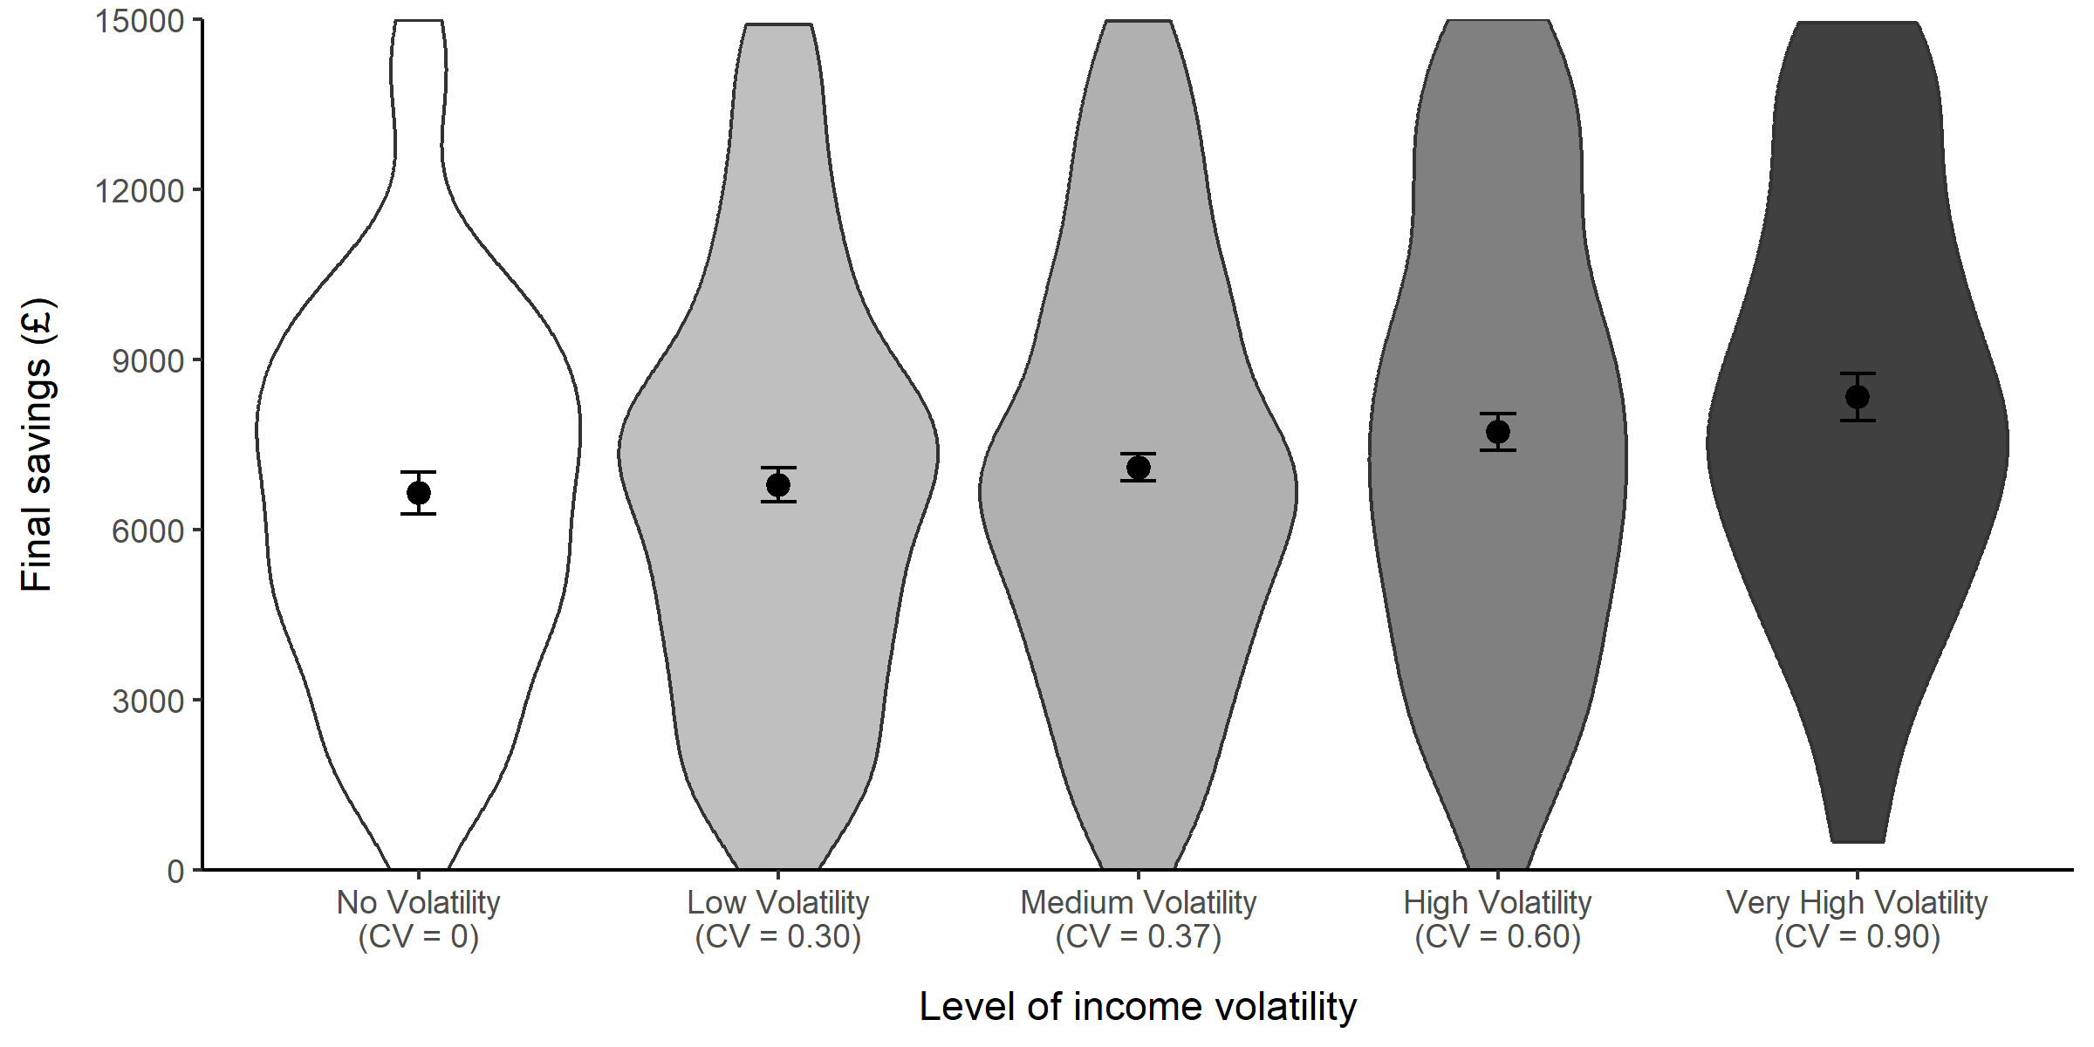
Experiment 4: Final savings
Strong evidence that participants saved more in the Very High Volatility condition compared to the No Volatility condition (BF₁₀ = 10.97).
By treating CV as a quantitative predictor:
Very strong evidence that higher CV was associated with more savings (BF₁₀ = 45.89).
A 0.1 increase in CV was associated with £213 more in savings.
* Note: Medium Volatility pools observations from the Same Min, Same Max, and Same Range conditions from Experiment 2.

Slide 36
04
Implications and future directions

Slide 37
What have we learned about income volatility and savings behaviour?
Across four experiments, we found that experiencing income volatility increased savings behaviour within our task.
There may be a ‘volatility threshold’ that needs to be exceeded before people adjust their behaviour.
Our findings are consistent with economic theories of uncertainty and saving behaviour.
Did not find evidence of increased financial impatience as in West et al. (2020) and Peetz et al. (2021).
However, our results may indicate people’s intentions to save more when faced with uncertainty.
In the real world, there may be reasons why people do not follow through with these intentions (e.g., if they make shortsighted decisions while under financial stress).

Slide 38
What have we learned about uncertainty and savings behaviour more broadly?
Uncertainty affects people’s financial decision making differently depending on their perceived financial situation.
Income uncertainty
Goal uncertainty
Macroeconomic uncertainty
We save more when our income is uncertain, and we don’t have to worry about the short-term.
We save more to be safe for uncertain goals, but only if we think it is achievable.
Consumers who were in the poorest financial situations had to trade off their future welfare.

Slide 39

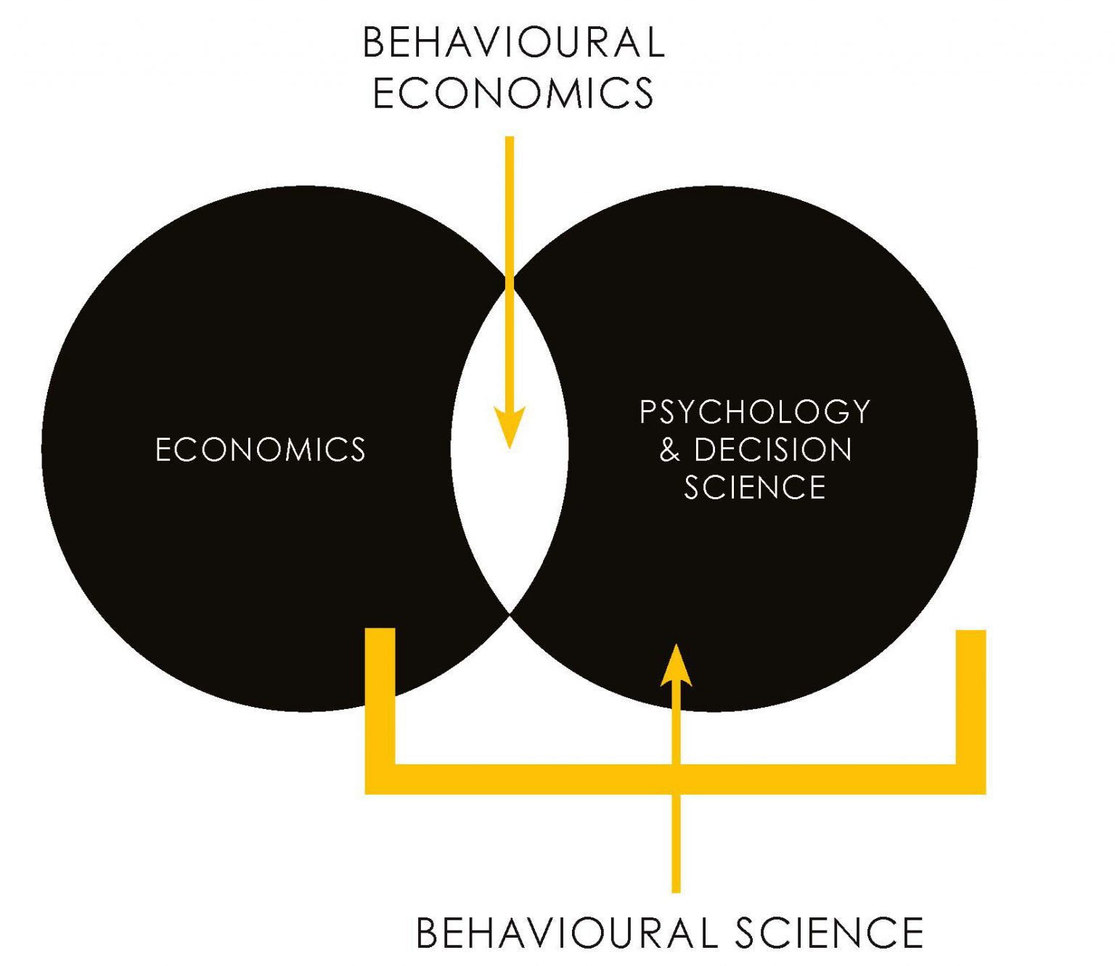

Future directions for research
How do we better understand how people perceive uncertainty?
How do we better combine economic and psychological perspectives on uncertainty?
How do we help people overcome the challenges of making financial decisions under uncertainty?

Slide 40
Thanks!
Reach out if you have any questions ☺
Nathan Wang-Ly (nathan.wang-ly@unsw.edu.au)

